Slide 1

Development Velocity; Single Track; or Continuous Integration—Pick Two
Richard Balocca
Technical Lead,
World Class Development Initiative
Ericsson Silicon Valley

Slide 2

About Ericsson
Founded in 1876
Leaders in telecom company with 100K+ employees
The networks group of which I am a part delivers products and solutions for:
Mobile radio and cellphone access
Internet protocol transport
Core networks

Slide 3
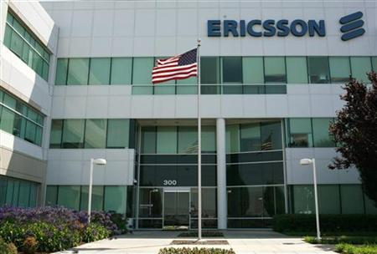
Presence in Silicon valley
Campus: 1000+ employees in one campus (we’re hiring)
Colo: Separate facility for development and test
Research: an Ericsson Research Center
Software Development: Common Component for routing
Hardware Development: products containing the Common Component

Slide 4

Our It environment
Eight data centers (hubs) worldwide. These tier 4 rated hubs provide:
Electric Commander in San Jose hub
Electric Accelerator in many hubs
In the San Jose hub: 600 agent EA cluster with 10GB infini-band networking
GIT/GERRIT and Artifactory masters in the Montreal hub with mirrors in the other hubs

Slide 5
Why Electric Accelerator?
Electric Accelerator vs. gmake –J16

Slide 6
DEVELOPMENT Environment
Follow-the-sun development offices in the US, Canada, Europe, India, and China.
1000+ engineers doing an average of one commit per week each
70K files in code base
More than 14 target images per build from this code base (about 6 GB total)–most going into blades for a large, fully redundant server product

Slide 7
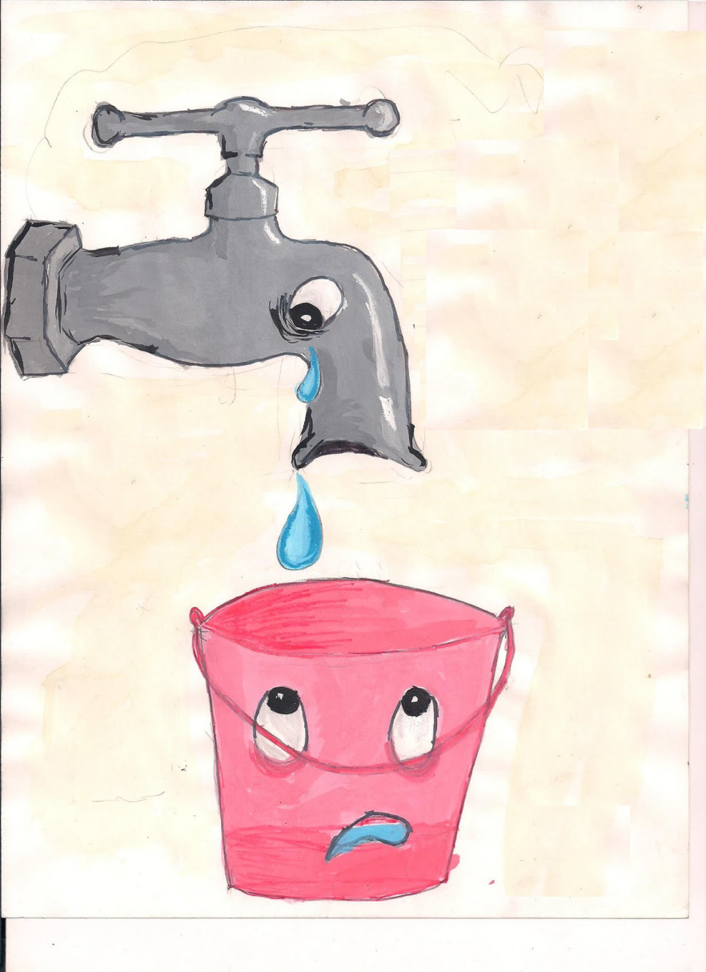
Where We Were
One nightly build per branch
Lots of branches
Even successful builds might not boot
Frequent code breakages and locks resulted in just a few testable build images per week
was not ci

Slide 8

What is Continuous Integration?
“Continuous integration (CI) is the practice, in software engineering, of merging all developer working copies with a shared mainline several times a day.
it is not just doing a lot of daily builds.

Slide 9
What Could Possibly go Wrong?
Short answer:
Anything and everything. For instance, one Friday evening a single engineer changed a copyright in a comment…
/*
Copyright Ericsson, Inc. 2013
* /
Notice anything wrong?

Slide 10
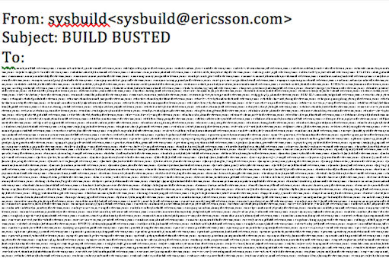
How many engineers does it take to fix the build?

Slide 11
What about Continuous Integration?
1000 Developers x 1 commit/week == 1000 commits/week!
Each build was taking 1 hour; CI would mean 24 commits per day
Even if we speed that up to 1 build every 6 minutes, that’s still only 240 commits per day.
Oh, and we needed to add a 1 hour sanity test to each build & we need to be single track…

Slide 12
What to Do?
Create preflight staging repos which are the gateway to public source repos
These repo are not visible to developers
Pre-check static source code requirements before acceptance to a preflight repo
These commits are only accepted if they have no merge conflicts with:
The public source repo
The other commits in preflight repo
The other commits currently being built

Slide 13





pull
push
Checks
User 1 - Workspace
Mailer to users
Pre Flight
GIT Repo
Main
GIT Repo
BUILD
SMOKE
pull
push
Checks
Sync Pre-flight -> Main Repo
User 2 - Workspace
Merge conflict
Static analysis failed

Slide 14
Now the Magic
The Electric Commander preflight process is…
A full build of all pushed commits in a staging repo
A sanity test
If either the the build or sanity test fails, the preflight commits are dumped. They don’t go into the public repo and the developers who committed to the preflight are told they failed preflight. No one else needs to get the e-mail.
Re-push instead of “back-outs”
The developer can simply re-push if they find they are not at fault. No need to do any code reverts, as the code never appeared in the public repo.

Slide 15
The new developer experience
Less shouting
E-mail only to the developers in the prefight failure (plus subscribed, interested parties)
No locking
No back-outs
No fire-drills
Less confusion
What builds?
What boots?
What went wrong with my commit?

Slide 16
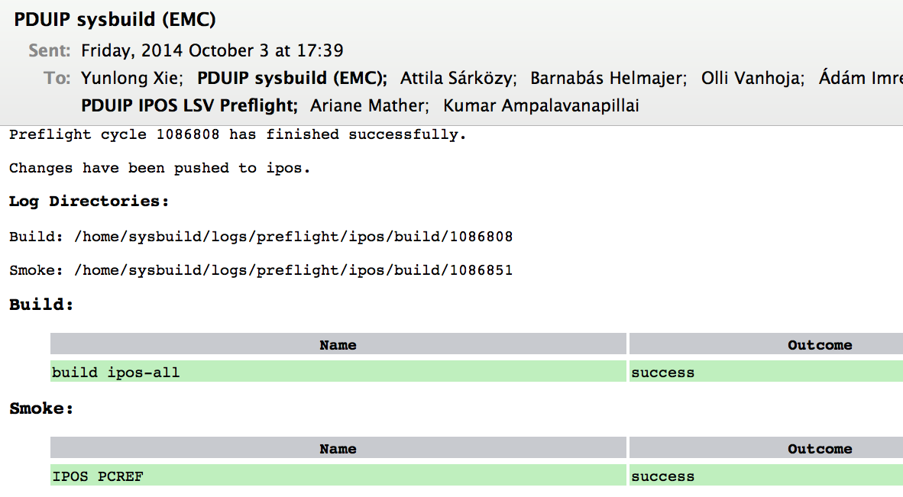
Targeted preflight E-mails

Slide 17

But that Takes Two Hours!
One hour for the build and one hour for the sanity test
This means that there might be quite a few commits in each preflight—perhaps 50
That’s a raft with 50 passengers and one may have a sharp object…

Slide 18
Pipelining to the Rescue
Sanity Test
Publish commits
EA Build
Hour 0
Sanity Test
Publish commits
EA Build
Hour 1
Hour 2
Hour 3
Scheduled by Electric Commander: One Electric Accelerator “Build Resource”
+ One “Test Resource”
= One preflight per hour

Slide 19
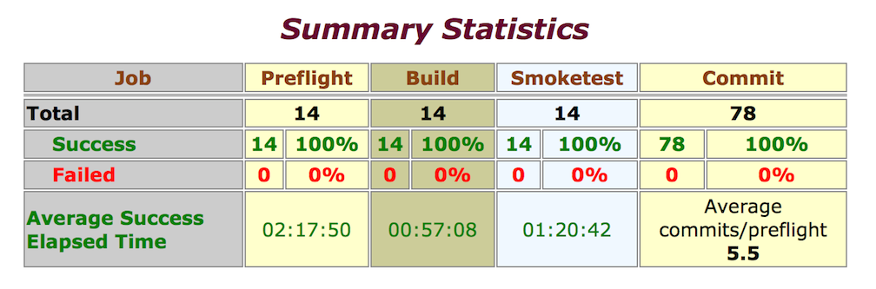
Preflight summary stats for July 10th

Slide 20

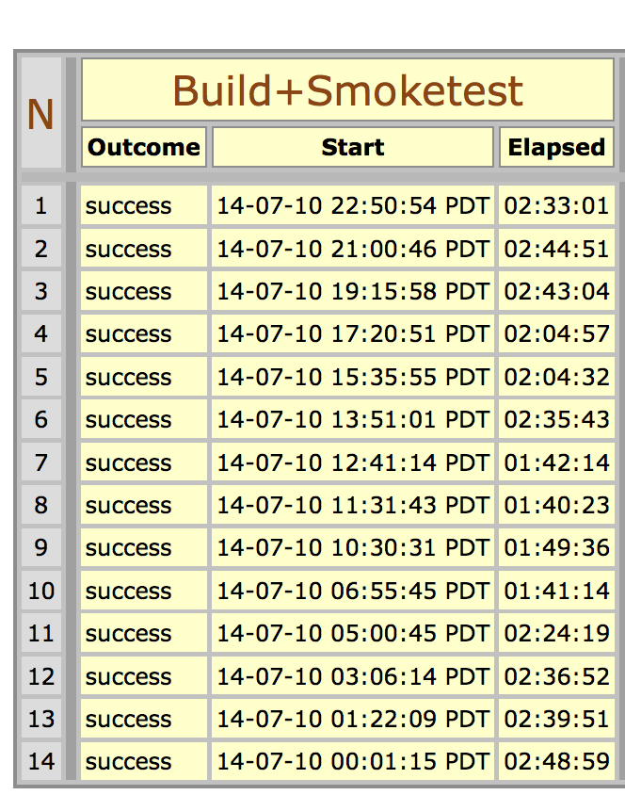
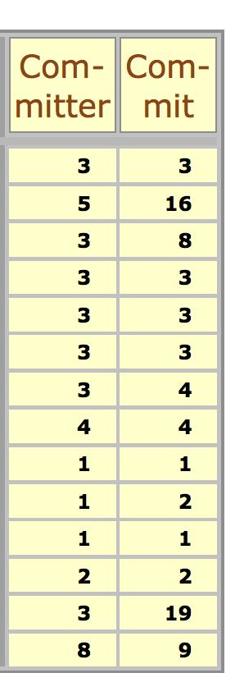
July 10th was A Sunny Day

Slide 21

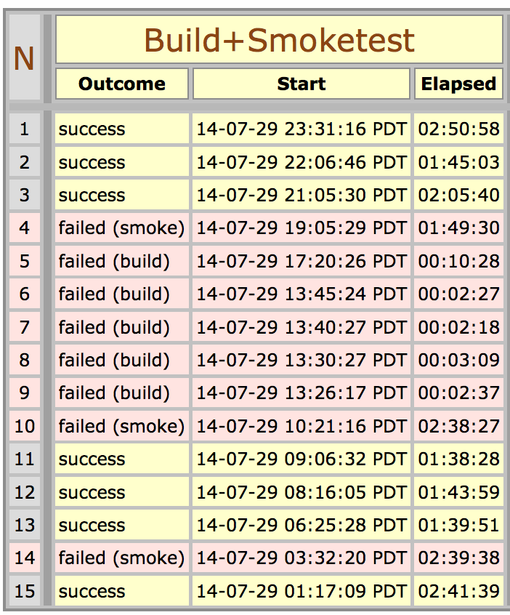
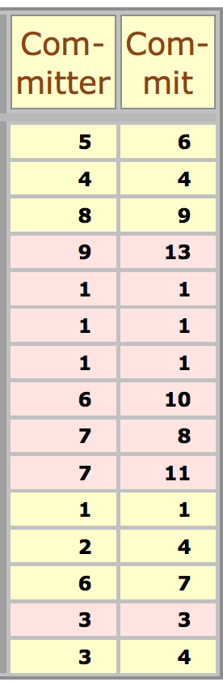
Fast fail Feedback

Slide 22
The future: Approaching CI
Tune to desired result by adding build and test resources
Multiple pipelines
Eager execution to avoid pipeline stalls
Pipe 1
build commit set A
Pipe 2
build commit set A+B
build commit set B
Select build A+B or B depending on the results of A

Slide 23
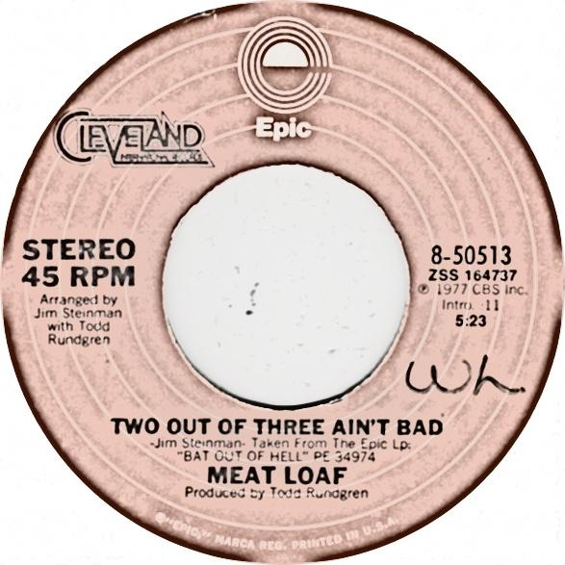
Our PICKS
High Development Velocity
Single Track
Preflight pipelining to simulate CI--tuned to the desired compromise between resources and preflight batch size

